Slide 1
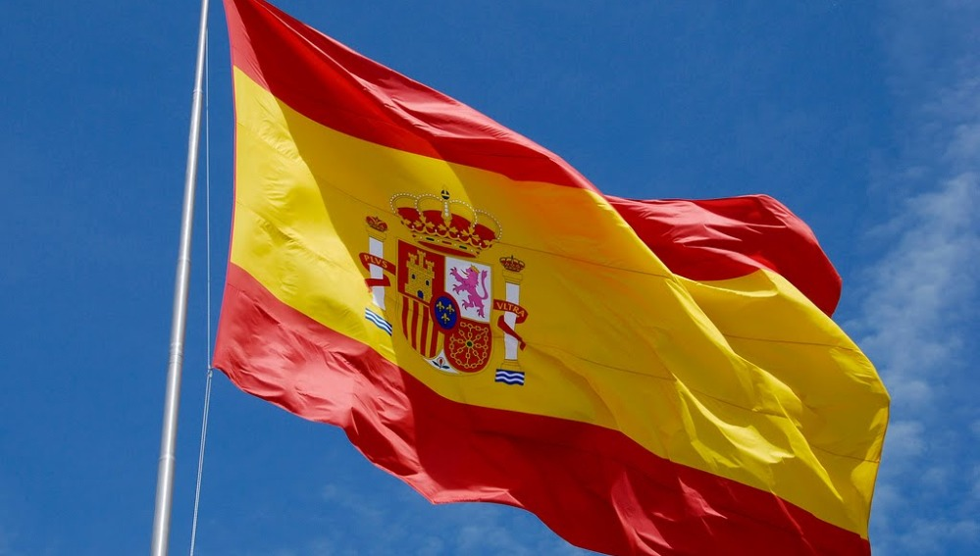
Spain
By Rachel, Faela and lonely Cathal

Slide 2
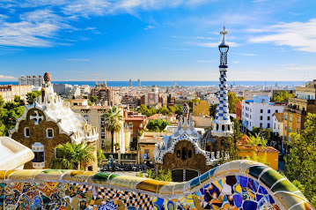
Facts about Spain
Spain is a country on the Mediterranean Sea.
Their flag is red and yellow
The population of Spain is 46,441,049 in 2019.
The capital city of Spain is Madrid.
The Spanish currency is the same as the Irish euro.
The continent that Spain is in is Europe.

Slide 3
Food in Spain
The types of food they eat in Spain are:
Croquettes:
Tortilla Espanola:
Gazpacho or salmoreijo:
Pisto- Spanish Ratatouille:
Cured meats- jamon, chorizo and salchichon:
Pulpo a la gallega:
Paella:
Prawns in fried garlic:

Slide 4
Famous people + Spanish Culture
There are lots of famous people in Spain here are a few of them:
Penelope Cruz
Javier bardem
Elsa Pataky
Ricky Martin
Eric Cantona
Spanish culture is known for Flamenco music and dance, Bullfights, fantastic beaches and lots of sunshine. Another thing known in Spain is the Spanish guitar which was invented in Andilusia in the 1790s when a sixth string was added to the Moorish lute.

Slide 5
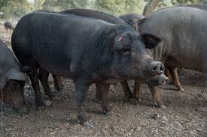
Animals in Spain
The Black Iberian pig weighs 90kg at the age 14 to 15 months. They are currently found in herds in the centre and southern part of Portugal and Spain. Their skin is normally black or grey.
The brown bear has a sturdy bone structure and large paws with claws that can be measured up to 4 inches long. It can weigh up to 1,058 pounds.

Slide 6
Spanish Language
Hello - Hola
Goodbye – adios
Good morning – Buenos Dias
Ice-cream – Helado
Spain – España
Boy – Nino
Girl – Nina
Thank You – Gracias
Yes – Si
No – No
Stop – Detener
Go – Ir
Santa Clause – Papa Noel

Slide 7
Festivals + Types of clothes in Spain
There are lots of different types of festivals in Spain.
In Spain Easter is celebrated for an entire week before Easter Sunday Semana Santa or Holy week sees parades celebrating the country's Catholic Romans heritage.
Celebrated on January 6th, Epiphany which is better known as the Twelfth Night in English. It is a religious holiday connected to Christmas but in Spain many people don’t open their Christmas presents until Epiphany.
Today most people still wear the traditional clothing in Spain, such as Mantilla- a long lace or silk veil that woman wear over their heads and shoulders.
In Spain if you wear shorts it is a dead giveaway that you are a tourist. Locals always wear trousers, skirts or dresses

Slide 8
The end
By Rachel Faela and Catolico

