Slide 1
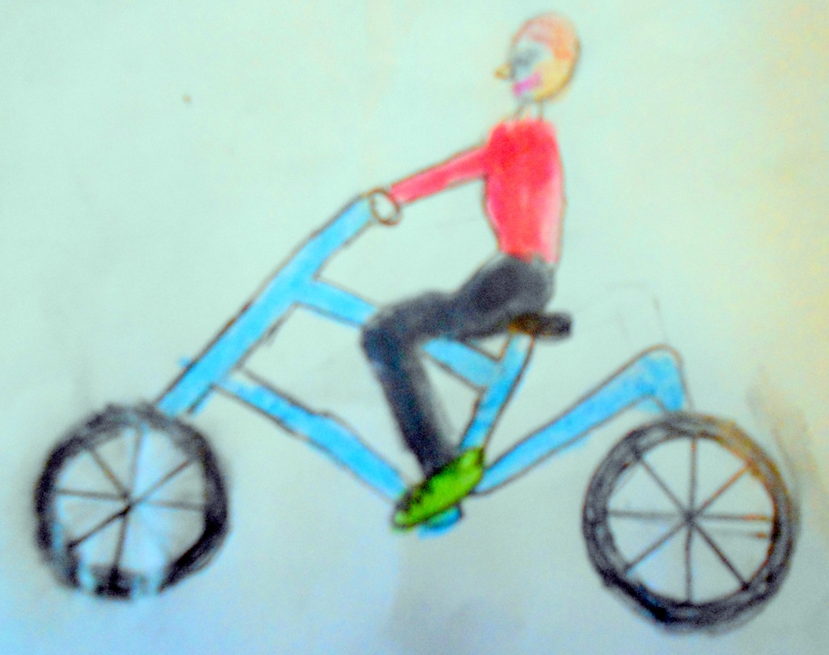
Ronan’s Bicycle
A project by Ronan, Rang 2
2014

Slide 2
Why I like my bike
I like my bike because I can ride around on it.
My brother and I play cops and robbers on our bikes. It is good fun.
My parents bought me my bike for my birthday.
My bike looks cool.
Sometimes the family go for walks and I ride my bike.

Slide 3
My bicycle
My bicycle has two wheels. I don’t need stabilisers because I have been riding a bicycle for two years. I took this photo on 4th December 2013

Slide 4
THE BICYCLE WHEEL
The valve keeps the air in the tyre
Here is the tyre. It is made of rubber.
It is full of air. When it is punctured you cannot use the bicycle.
A bicycle wheel has many spokes.
Wheel rim
My tyres have good grips for going cross country.

Slide 5
Pedals and brakes
You need pedals to power your bike. You use your feet to push the pedals. The pedals are connected to a chain. The chain is connected to the wheels. This is how the bicycle works.
The brakes help you make your
bicycle stop.
Valve and valve cap
The chain.

Slide 6
The handlebars and gears
My bike has six gears
You need brakes to stop your bike.
Sometimes you have stop in an emergency.
You need brakes to stop your bike going too fast.
Gears are for helping you to ride your bike on hills and rough ground.
You must look after your gears and brakes so that your bike is safe.
Here are the brakes

Slide 7
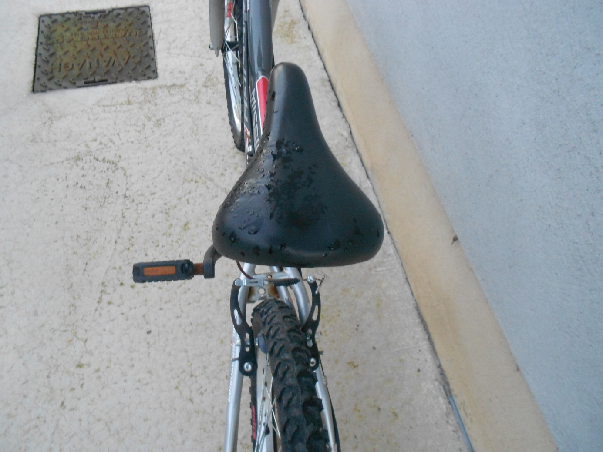
The Saddle
The saddle is where you sit although sometimes when you are cycling you stand up on the pedals.

Slide 8
Safety lights
A white front light and a flashing red tail light are really important if you are riding your bike at dusk or at night.
Reflectors on your wheels or pedals
reflect street lights and car lights
and help people see you
A bell lets other road users know you are there

Slide 9
Handlebars
The brake lever, the gear lever and the bell are on the handlebars.
The handlebars help you to steer your bike.

Slide 10
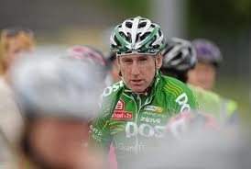
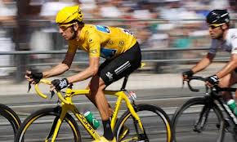
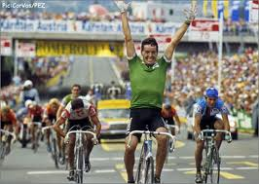
Bradley Wiggins
Sean Kelly
Bradley Wiggins
Stephen Roche
Famous Irish cyclists include Sean Kelly and Stephen Roche
In 2012, Bradley Wiggins won the Paris–Nice, the Tour de Romandie, the Tour de France and the time trial at Olympic Games.

Slide 11
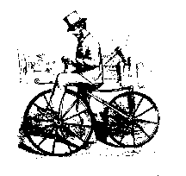
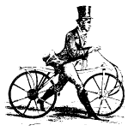
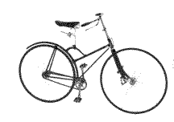
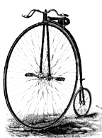
Who invented the bicycle??
There were lots of different people trying to invent a bicycle.
1817 - The first bicycle had no pedals!
1865 Pedals on the front wheel
100 years ago bicycles began to look like this
1870. This one was very dangerous!

Slide 12
The End
I hope you enjoyed my PowerPoint presentation about the bicycle.
I really like cycling on my bicycle.
It is a good way to travel and it is a good way to keep fit and healthy too.
Ronan O’Reilly

