Slide 1
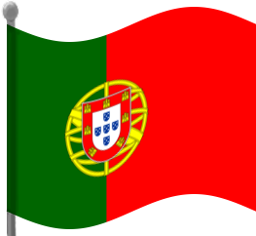
Portugal
By Amy

Slide 2
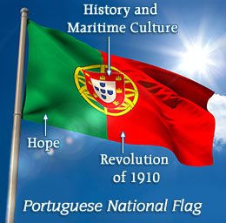
Portuguese flag
The length of the flag is 1 ¹⁄₂ times it’s width. It claims that the green represented the hope of the Portuguese people, while the red represented the blood of those who died serving the nation
Sources believe these noble meanings are far from the truth and are nothing more than propaganda, to provide an honourable justification to their choice.

Slide 3
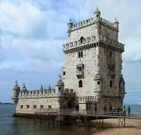
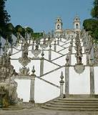
Tourist attractions, Belém Tower and Bom Jesus do monte
Belém Tower or the Tower of St Vincent is a fortified tower located in the civil parish of Santa Maria de Belém in the municipality of Lisbon, Portugal
Bom Jesus do Monte is a Portuguese sanctuary in Tenões, outside the city of Braga, in northern Portugal. Its name means Good Jesus of the Mount

Slide 4
Fun facts
Capital: Lisbon
Population: 10.46 million (2013) World Bank
Currency: Euro
National language: Portuguese
Portugal is a southern European country on the Iberian Peninsula, bordering Spain and the Atlantic Ocean. Its ocean side location influences many aspects of its culture l language: Portuguese

Slide 5
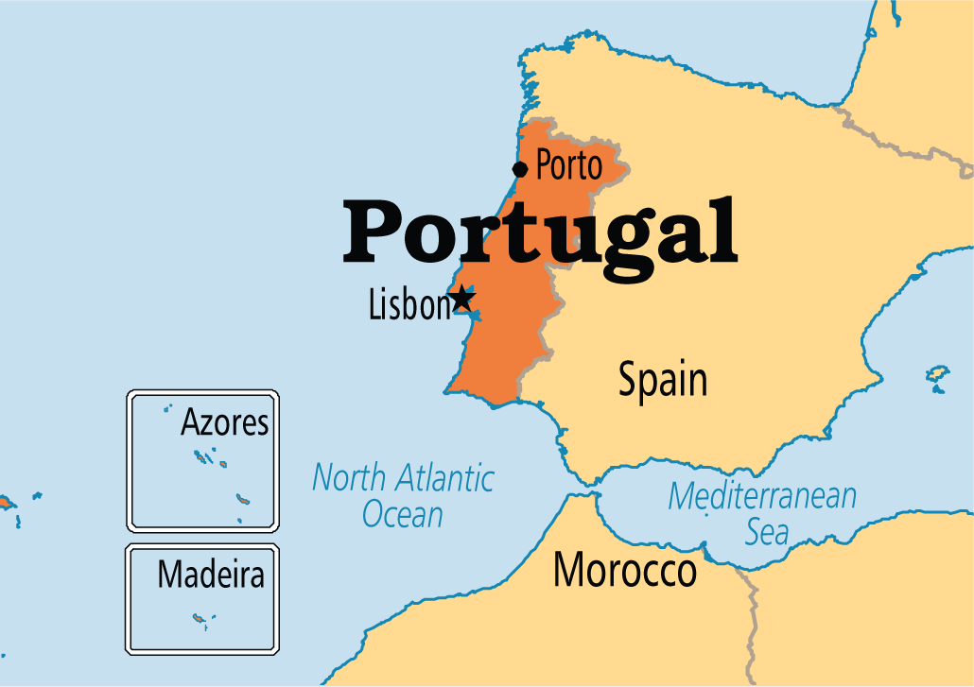
Portugal’s situation
Portugal is a coastal nation in southwestern, Europe bordering Spain and the north Atlantic ocean to the other side of Portugal. One of the main reasons Portugal is such a main tourist attraction is because isn’t a land locked country. The biggest city in Portugal is it’s capital Lisbon with a population of 517,802. The Tagus is the longest river on the Iberian Peninsula. It is 1,038 km long, 716 km in Spain, 47 km along the border between Portugal and Spain and 275 km in Portugal, where it empties into the Atlantic Ocean near Lisbon.

Slide 6
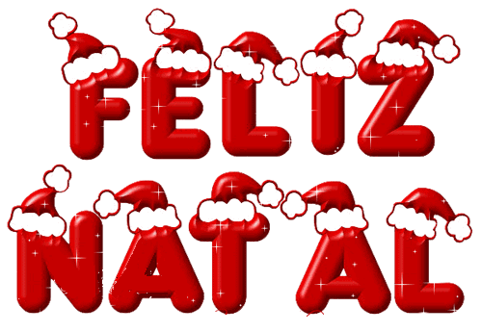
Portuguese traditions “feliz natal”
Holiday Traditions of Portugal "Feliz Natal" On Christmas Eve Portuguese families gather around the Christmas tree and the Crèche (Crib) to celebrate the birth of Jesus. Catholicism is the main religion in Portugal.

