Slide 1
All about OLD measures
The story of measurement long ago
(to be completed)

Slide 2
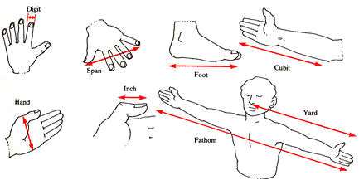
How can you measure without a ruler or tape?
Use something you have
Use your hands or feet
Use a piece of string

Slide 3
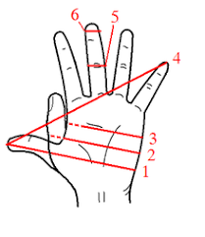
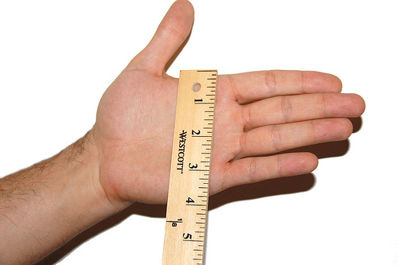
Span or Hand
A span in terms of old measurements was the distance between the tip of your little finger and the tip of your thumb when your hand is stretched out.
This is about 4 inches or 10cm.
The word span is used to
Describe the space or distance between
Two points
We say the “span of a bridge”

Slide 4
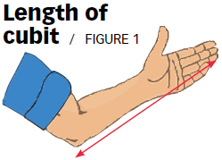
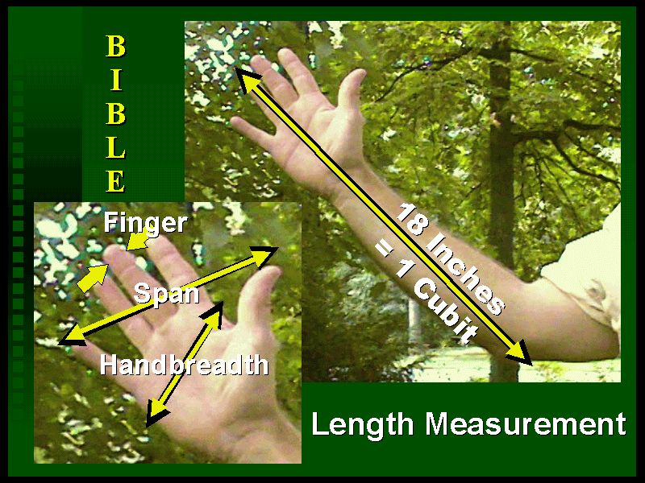
Cubit
A cubit is the length of your arm from the tip of your elbow to the tip of your middle finger.

Slide 5
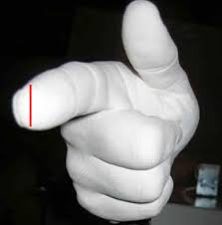
Digit
The width of your finger

Slide 6
Fathom

