Slide 1
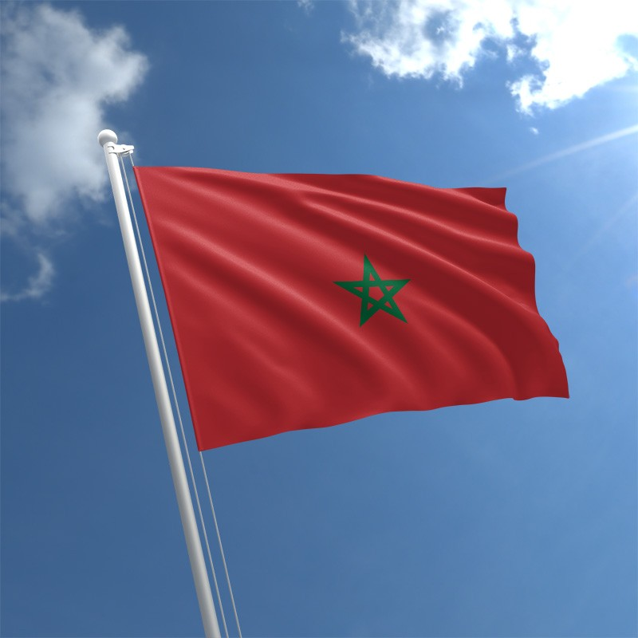
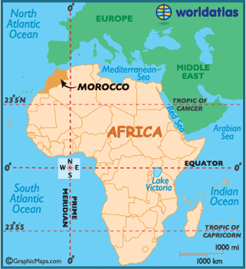
Morocco
By Mathew and Cillian

Slide 2
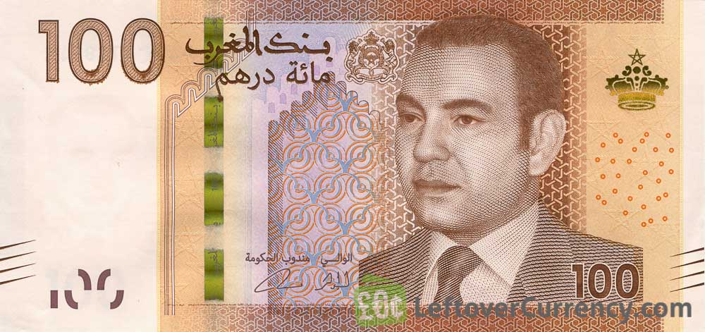
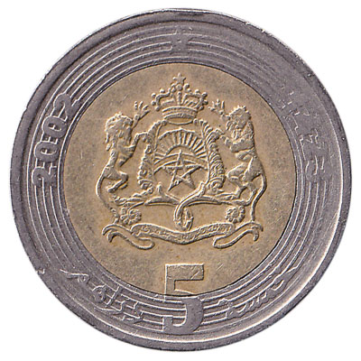
Facts
Morocco is in North Africa
The capital is Rabat
The currency is Moroccan dirham
35.74 million live in Morocco this was recorded in 2017

Slide 3
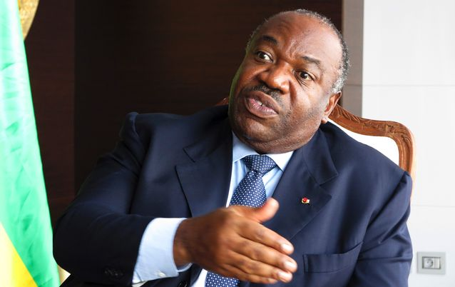
President of Morocco
The President of Morocco is Ali Bongo Ondimba

Slide 4
Famous people from Morocco
Mohammed Hajoui
Mohammed Khair Eddine
Leila Abouzied
Mohammed Berrada
Mohammed Choukri
Mohammed Kaghat
Halima Ferhat

Slide 5
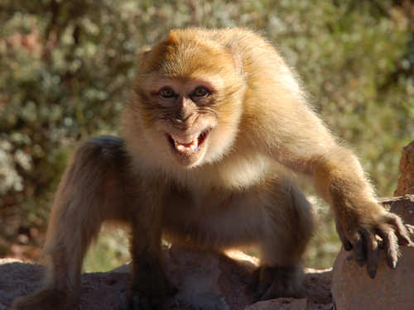
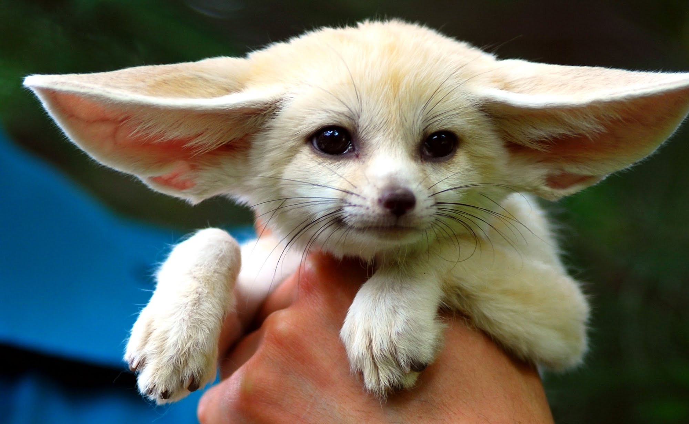
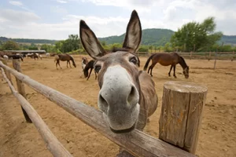
Animals
Desert Biome
Barbary Sheep
Sand cat
Barbary Macaque
Crested Porcupine
North African hedgehog

Slide 6
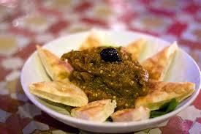
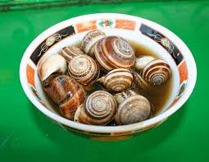
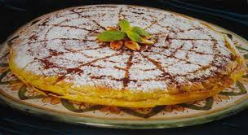
Food
Harira
Steamed sheep head
Spicy sardines
Pastille
Pigeon Pie
Sheep
Liver
Tangia

Slide 7
History
The recorded history Morocco begins with the Phoenician colonization of the Moroccan coast between the 8th and the 6th centuries BCE although the area was inhabited by indigenous Berbers for some two thousand years before that half a centaury later the Moroccan state was established by the Idrised dynasty. Also on the

Slide 8
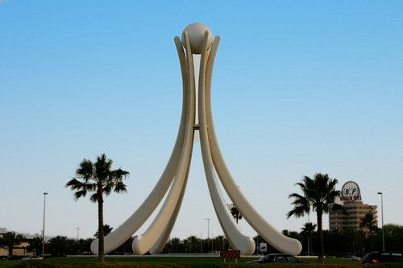
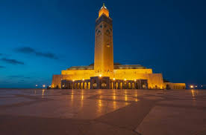
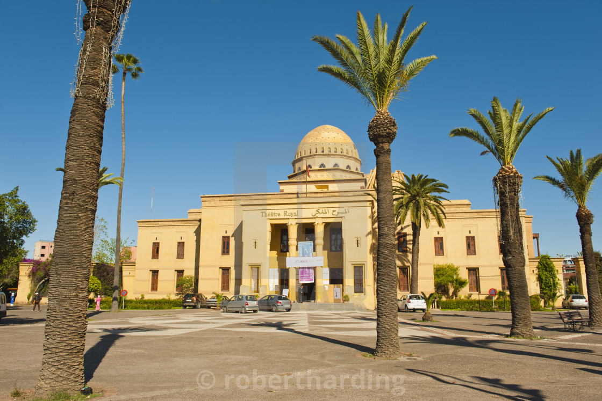
Landmarks
Here are some landmarks in Morocco

Slide 9
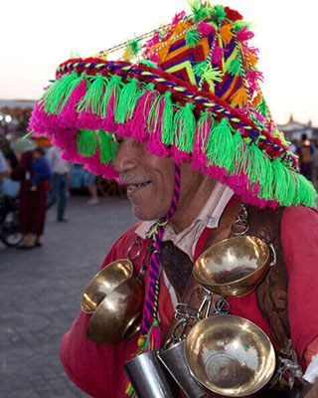
Traditions
In Morocco some of the traditions are Drinking Mint Tea and Morocco celebrate Green March Day, Labour Day, Eid Al Fitr, Eid Al-Adha and Islamic New Year.

Slide 10
The End

