Slide 1
1
What three shapes can you see in the centre of the playground?

Slide 2
2
Count how many cars you can see passing up the road in one minute.

Slide 3
3
How many vertical poles can you count on the football pitch?

Slide 4
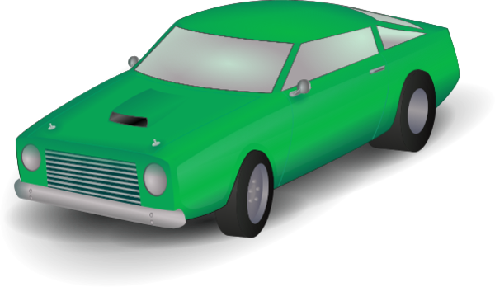
4
How old will Ms. Brennan’s car be in 12 years?

Slide 5
5
Start at the red cone in the corner of the football pitch and count how many ribbons are tied to the fence between it and the second red cone.

Slide 6
6
There is a bag of money under the pink cone in the far corner of the pitch. How much money is in the bag?

Slide 7
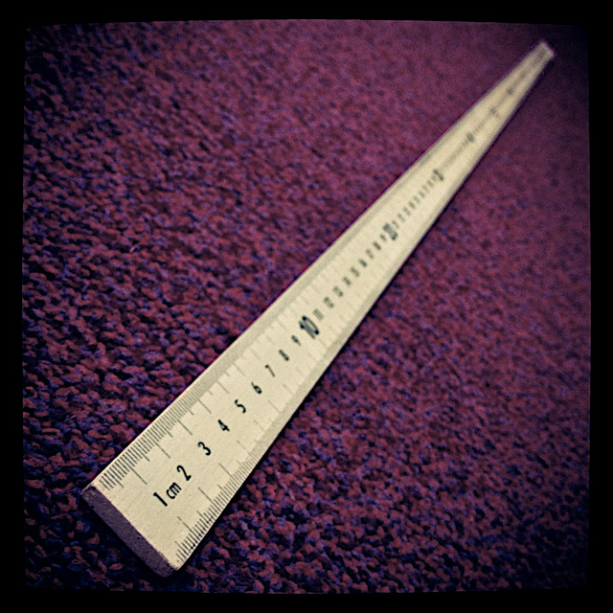
7
Measure the distance between the two blue cones with the metre stick.

Slide 8
8
How many emergency doors are there on the school part of the building?

Slide 9
9
Try and work out this problem
Today Cillian got a bag of sweets for being good at his writing. There were 25 sweets in the bag. He gave 7 to Adam and he ate 8 himself. How many sweets were in the bag to begin with?

Slide 10
10
Work out the riddle
If you give me water I will die. What am I?

