Slide 1
IVORY COAST
By Adam and Ethan

Slide 2
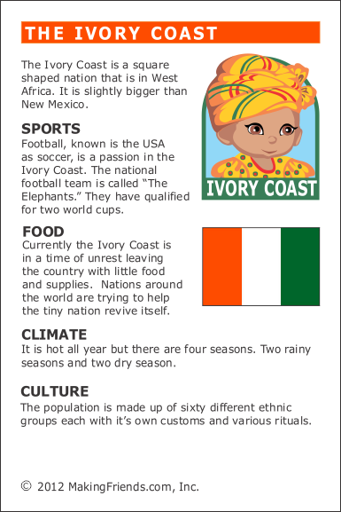
Facts about Ivory Coast
Ivory Coast is in the continent of Africa. DescriptionCôte d'Ivoire is a West African country with beach resorts, rainforests and a French colonial legacy. Abidjan, on the Atlantic coast, is the country’s major urban center . Its modern landmarks include zigguratlike, concrete La Pyramide and St. Paul's Cathedral, a swooping structure tethered to a massive cross. North of the central business district, Banco National Park is a rainforest preserve with hiking trails.

Slide 3
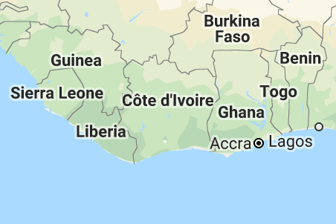
Population
The population of Ivory Coast is 24.29 million

Slide 4
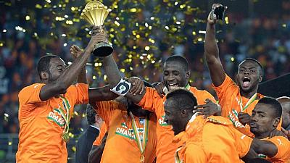
Football in Ivory Coast
Football in Ivory coast. Football is the most popular sport in Ivory Coast. The national team won the Africa cup of nations in Senegal.

Slide 5
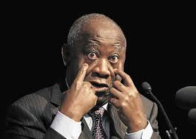
Alassane Ouattara
Alassane Ouattara is the president of Ivory Coast

