Slide 1
Italy
By Conor Mc Anenly

Slide 2
Facts About Italy
Did you know the author of Pinocchio was from Rome.
There is over 50 million tourists that visit Italy each year.
The current population of Italy is 59,245,458 million.

Slide 3
Clothing
Some of the world’s most famous brans in the world are designs like Gucci, Georgio Armani and Diesel.
Unlike us they wear trousers and jumpers when it is hot.

Slide 4
Capital City
The capital city of Italy is Rome.
There is a tall tale of two brothers Romulus and Remus who founded Rome.
The city's population is 2.873 Million.

Slide 5
Government
The president of Italy is Sergio Mattarella.
The Italian government was founded on the 2nd of June 1946.
The Italian people are allowed to vote in a Regional vote twice.

Slide 6
Food In Italy
The most popular food in Italy is Pizza and Pasta.
Pizza was founded in Italy in 1861.
Pasta was founded in China in1271

Slide 7
Animals in Italy
Here is a popular dog in Italy his breed is called Lagotto Romagnlo.
There is another popular dog breed in Italy called the Neapolitan Mastiff.
There is a popular breed of cattle called Chianina.

Slide 8
Religion in Italy
Religion in Italy is part of their everyday life.
There is a very famous man in Italy who is called Pope Francis.
Their belief is Jesus, God and Mary.

Slide 9
Sport in Italy
Italy’s most popular sport is Cycling.
A famous soccer player in Italy is called Marco Verratti.
There is some other very popular sports in Italy like Basketball, Soccer, and Volleyball.

Slide 10
Culture in Italy
There is a traditional dance in Italy called the Folk Dance.
They also hold a big carnival during the first and last week of February.
Italy are also massive fans of food.

Slide 11
School System
They go to the nursery school from the age of 3-5.
They go to Primary school from6-11.
They go to secondary school from the age of 11-19 then University.
They all wear school uniform.

Slide 12
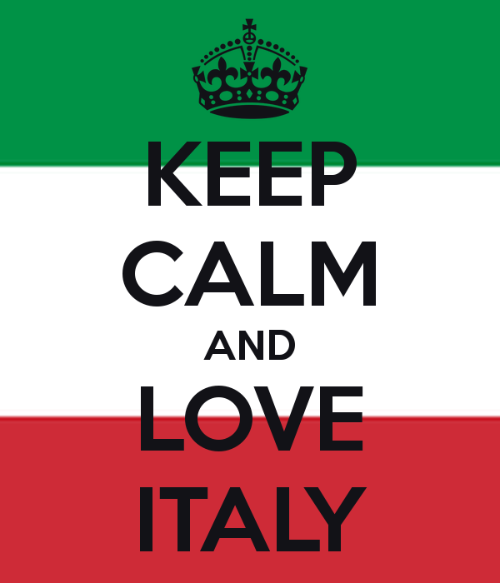
The End

