Slide 1
France
By Matthew T

Slide 2
ANIMALS IN FRANCE.
Animals living in France as native species include red deer, ibexes, genets, muskrats, otters, rabbits, Alpine marmots, lynxes, beavers, polecats, badgers, wild Camargue horses, ragondins and foxes. Protected species include pine martens, hen harriers, red squirrels, chamois, wild boar and peregrine falcons.

Slide 3
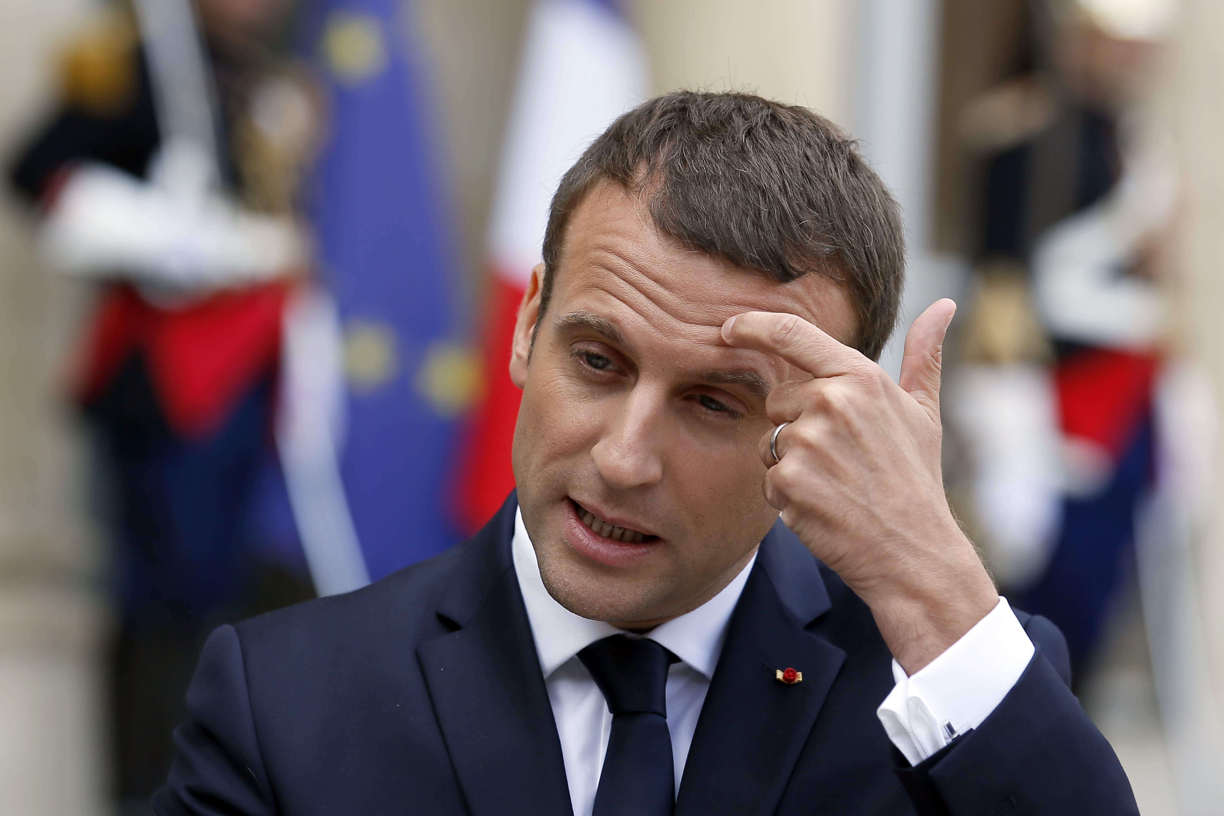
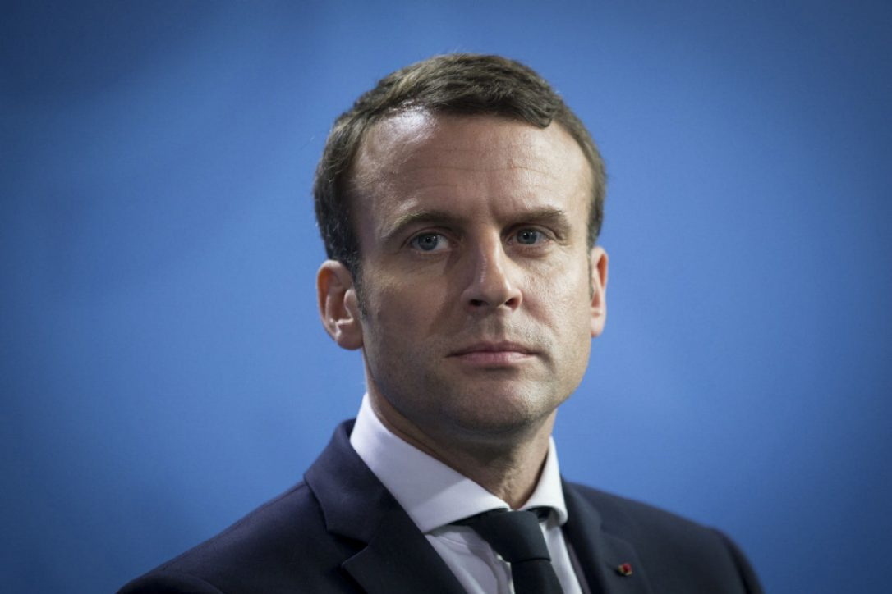
FACTS ABOUT FRANCE
1.FRANCE IS A COUNTRY IN EUROPE
2.THE FRENCH CAPITAL IS PARIS
3.THE FRECH PRESIDENT IS EMMANUEL MACRON
4.THE FRENCH PRIME MINISTER IS BERNARD CAZENEUVE
5.THE FRENCH POPULATION IS 66.9 MILLION

Slide 4
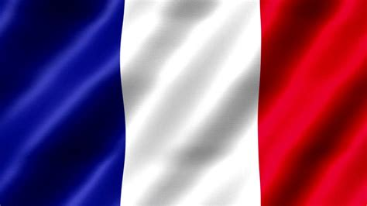
FRANCEIS AN IDEPENDENT COUNTRY.THIS IS THE FRENCH FLAG.

Slide 5
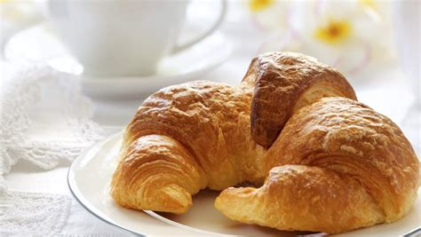
THIS IS A CROISSANT.IT IS A POPULAR MEAL IN FRANCE.

Slide 6
France has one of the most successful education. In French schools you are not allowed phones.
The French education system is one of the best in the world .There is no phones allowed at school

Slide 7
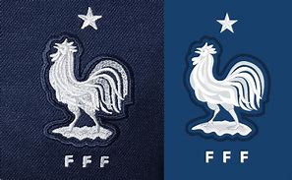
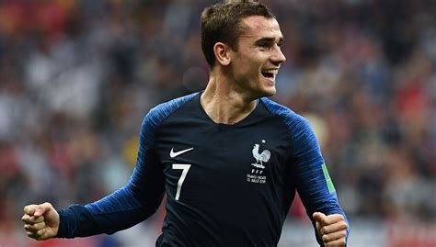
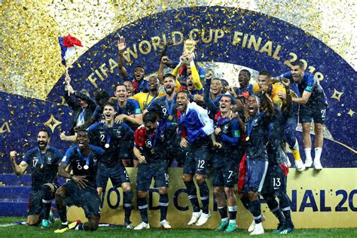
Soccer is the most popular sport in France . the France national soccer team is the best in the world their best player is Antoine Griezman. This is a picture of the French soccer crest.

Slide 8
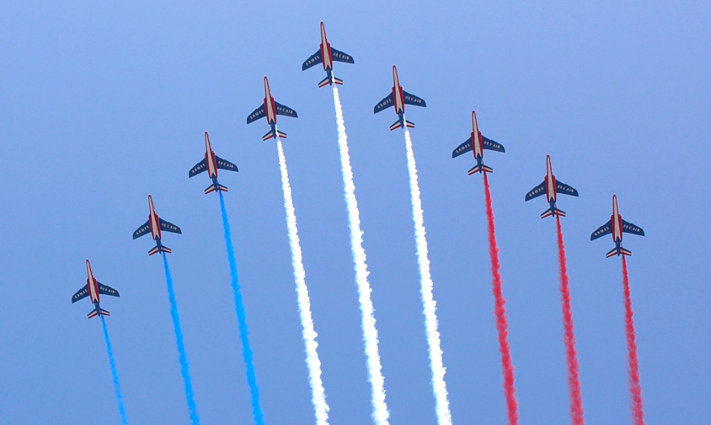
In France the to most important celebrations are bastille day and Cannes film festival.

Slide 9
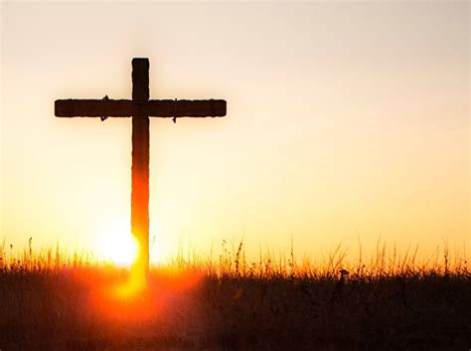
The most popular religion in France is Catholicism.

Slide 10
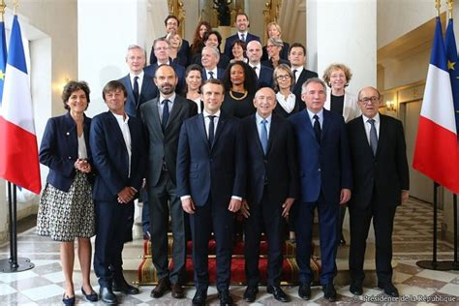
The French government.
This is a picture of the French government.

Slide 11
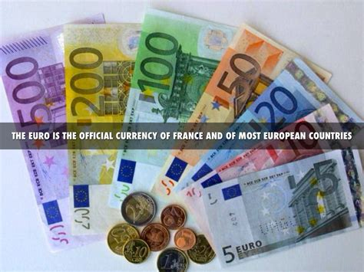
The currency in France is the euro.

Slide 12
WARS IN FRANCE
The Wars of Religion crippled France in the late 16th century, but a major victory over Spain in the Thirty Years' War made France the most powerful nation on the continent once more. In parallel, France developed its first colonial empire in Asia, Africa, and in the Americas

Slide 13
THE END

