Slide 1
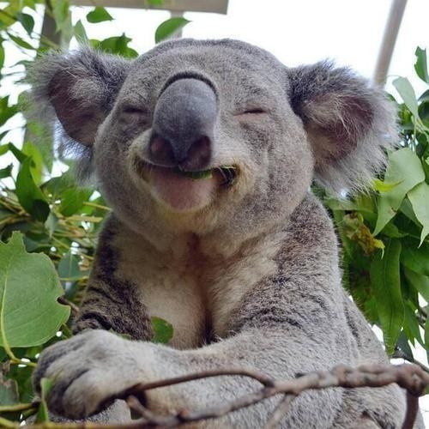
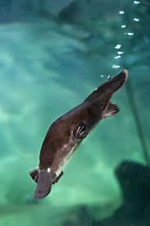
Australia

Slide 2
Australia has an estimated population of over 22 million people.
Australia is the world's 6th largest country by area.
Due to its large size and isolation from the rest of the world, Australia is sometimes known as the ‘island continent’.
The largest cities in Australia are Sydney, Melbourne, Brisbane, Perth and Adelaide.
A desert area known as the ‘outback’ covers much of the land.
The name ‘Australia’ comes from the Latin word ‘australis’, meaning southern.
It is estimated the humans have lived in Australia for around 45000 years.
The indigenous people of Australia are Australian Aborigines and Torres Strait Islanders.
The highest mountain on mainland Australia is Mt Kosciuszko, standing 2228m (7310ft) above sea level.

Slide 3
The world's largest reef system, the Great Barrier Reef, is found off the north-eastern coast of Australia.
Australia is home to a variety of unique animals, including the koala, kangaroo, emu, kookaburra and platypus.
Although they usually keep to themselves, there are a range of dangerous snakes in Australia, such as the Brown Snake, Tiger Snake and Taipan.
Australia has over 750 different reptile species, more than any other country in the world.
Australia is a relatively wealthy country with a high life expectancy.

Slide 4
kangaroo
No image of modern outback Australia is complete without a mob of kangaroos hopping across the horizon. Kangaroos belong to the Macropodidae family, meaning ‘big foot’ in Latin, in reference to the species’ unusually large hind feet.

Slide 5
SYDNEY
Sydney, capital of New South Wales and one of Australia's largest cities, is best known for its harbour front Sydney Opera House, with a distinctive sail-like design. Massive Darling Harbour and the smaller Circular Quay port are hubs of waterside life, with the arched Harbour Bridge and esteemed Royal Botanic Garden nearby. Sydney Tower’s outdoor platform, the Skywalk, offers 360-degree views of the city and suburbs.
Area: 12,368 km²
Weather: On average 14°C
Population: 5,131,326

Slide 6
THE GREAT BARRIER REEF
Lizard Island is on the Great Barrier Reef – meaning the reef and all of its wonders are yours to explore straight off the beach or just a short boat trip away.
The Great Barrier Reef spans over 2300 kilometres and is listed as one of the Natural Wonders of the world.
Lizard Island’s unique location on the reef places it at the centre of inner and outer reef systems as well as fringing reefs; all forming a critical part of the eco-system that is home to the most diverse, colourful and intriguing marine animal and plant life.
The wonders of Lizard Island’s location means that you have the rare privilege of simply stepping off the beach and snorkelling onto parts of the reef- witnessing the wonders of Giant Clam gardens and schools of tropical fish both big (our resident Groper, Simon, is over 200 kilos and likes to hang about close to shore) and small, manta rays, turtles and coral. Literally minutes by boat from the inner and outer reef systems with many fringing reefs to stop and explore on the way.

Slide 7
By Dylan Aaron and shea

