Slide 1
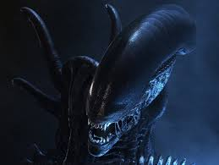
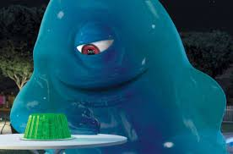
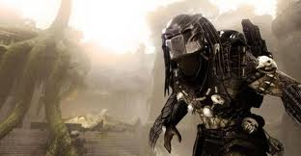
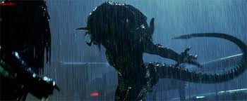
aliens
hello my name is Kian and my project is freaky and weird aliens

Slide 2
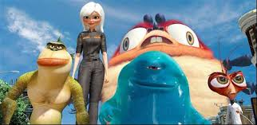
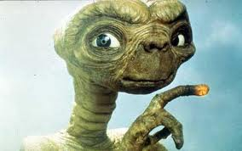
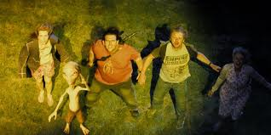
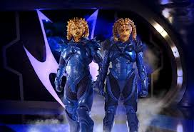
Films with aliens
Aliens are very famous cause they are in at lest 1000 films like men in black 1,2 and 3, Paul, monsters vs aliens, toy story 2 and 3, ET,ben10 the movie, aliens in the attic , my parents are aliens, mega mind, avatar, Sarah Jane, doctor who, wizards vs aliens and star wars. But that is not all there are more about aliens.

Slide 3
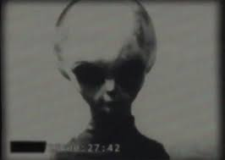
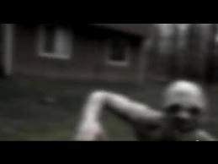
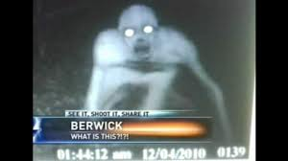
Are aliens real
There is no evidence which can guarantee that aliens exist, but this does not mean that aliens are not real. There is plenty of evidence that suggests they do exist and may have even once visited our planet Earth.

Slide 4
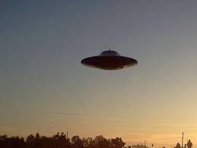
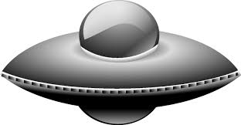
Alien UFOs
The History Channel has come out with the best, most powerful evidence yet on the existence of UFOs. Don't miss their astounding documentary at the first link below. One of the most popular shows ever presented on the Sci-Fi channel was the riveting documentary Out of the Blue, which mixes interviews with astronauts, generals, and other high-ranking military and government officials with remarkable footage of UFOs taken from around the world. Another excellent video is the National Press Club Video in which 22 government and military witnesses testify to their personal experiences in the UFO cover-up. Finally, Walt Disney Television produced a most unusual special titled Alien Encounters which alleges a major government cover-up of UFOs

Slide 5
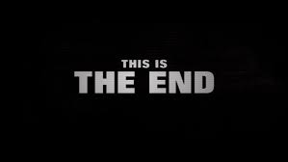

Slide 6
